Slide 1


Slide 2
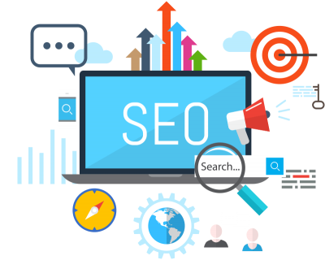
Basics of SEO

Slide 3
SEO (Search Engine Optimization) is the process of optimizing a website to improve its visibility in search engine results pages (SERPs)
What is SEO?
Definition
Purpose
Increase organic (non-paid) traffic to your website
Importance
Higher visibility leads to more visitors, which can translate into increased sales, leads, and engagement

Slide 4
Types of SEO
1. On-Page SEO
Focuses on optimizing content and HTML source code on your own website
2. Off-Page SEO
Involves activities outside your website that impact rankings, such as building backlinks
3. Technical SEO
Enhances the technical aspects of a website to improve ranking, including factors like site speed and mobile-friendliness

Slide 5
On-Page SEO Fundamentals
Key Elements
Title Tags
Include primary keywords and your brand name to improve relevance
Meta Descriptions
Brief summaries that encourage clicks; they appear under the title in SERPs
Headers (H1, H2, etc.)
Structure content logically and include keywords for better indexing
Content Quality
Provide valuable, relevant, and original content that meets user needs
Keyword Optimization
Use keywords naturally throughout the content to improve relevance without overstuffing

Slide 6
Off-Page SEO Fundamentals
Key Strategies
Backlinks
Links from other websites to your site; they act as votes of confidence and improve authority
Social Media Engagement
Promote content on social media platforms to increase visibility and generate backlinks
Guest Blogging
Write articles for other websites to gain backlinks and exposure to new audiences
Importance of Authority
High-authority sites linking to yours can significantly enhance your ranking potential

Slide 7
Technical SEO Basics
Key Components
Site Speed
Faster loading times enhance user experience and positively impact rankings
Mobile Optimization
Ensure responsive design for a better mobile user experience, as mobile-friendliness is a ranking factor
Sitemaps
Help search engines understand your site structure, facilitating better crawling and indexing
Robots.txt
Informs search engines about which pages to crawl or ignore, helping manage site indexing

Slide 8
Simple Keyword Research Techniques
Importance of Keywords
Keywords are the terms users search for; targeting relevant keywords increases your site's visibility
Tools for Keyword Research
Google Keyword Planner
A free tool for finding keywords and understanding their search volumes
Ubersuggest
Provides keyword ideas and SEO insights, helping to identify opportunities
AnswerThePublic
Visualizes search questions and queries related to your keywords, aiding in content creation

Slide 9
Basic SEO Tools and Their Uses
Google Search Console
Monitor and troubleshoot your site’s presence in Google search results; analyze performance and indexing issues
Yoast SEO (for WordPress)
A plugin that helps optimize content and manage SEO settings easily within the WordPress platform
SEMrush/Ahrefs
Comprehensive tools for tracking keyword rankings, analyzing backlinks, and researching competitors

Slide 10
SEO Best Practices
Stay Updated
SEO is constantly evolving; follow industry blogs and updates to keep informed of best practices
Focus on User Experience
Prioritize creating content that provides value to users, enhancing their experience on your site
Avoid Black Hat Techniques
Stay away from unethical practices like keyword stuffing or buying backlinks, which can lead to penalties

Slide 11
Discussion Questions
What challenges do you think businesses face with SEO?
(Encourage students to share their thoughts on common obstacles in SEO.)
Have you ever tried to optimize content for search engines? What was your experience?
(Ask students to discuss their experiences, successes, or struggles with SEO.)

Slide 12


Slide 13


